Slide 1

MENTALYTICS TEAM
Capstone Project Proposal

Slide 2

Project Title
Analysis of Remote Work and Its Impact on Mental Health

Slide 3
Mentalytics Members
DA/2025/TC3/006 | DA/2025/TC3/032 | DA/2025/TC3/059 | DA/2025/TC3/141 | DA/2025/TC3/215 | DA/2025/TC3/216 | DA/2025/TC3/317 | DA/2025/TC3/417 | DA/2025/TC3/440 | DA/2025/TC3/473 | DA/2025/TC3/503 | DA/2025/TC3/550 | DA/2025/TC3/568 | DA/2025/TC3/593 | DA/2025/TC3/632 | DA/2025/TC3/667 | DA/2025/TC3/668 | DA/2025/TC3/696 | DA/2025/TC3/698 | DA/2025/TC3/754 | DA/2025/TC3/756 | DA/2025/TC3/771 | DA/2025/TC3/774 | DA/2025/TC3/796 | DA/2025/TC3/828 | DA/2025/TC3/861 | DA/2025/TC3/870 | DA/2025/TC3/882 | DA/2025/TC3/933 | DA/2025/TC3/1002

Slide 4
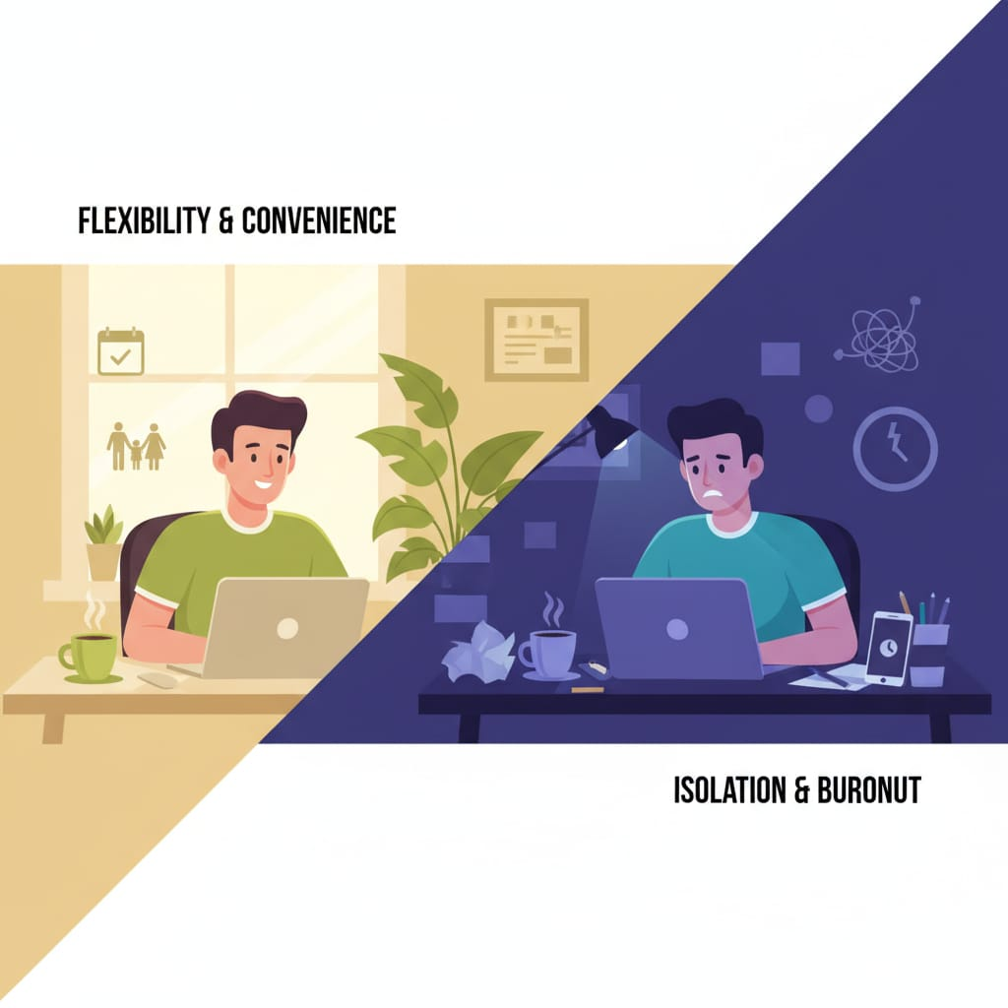
Introduction
The concept of remote work has become increasingly popular in recent years, especially after the COVID-19 pandemic. While it offers flexibility and convenience, it also poses challenges to employees’ mental well-being. Issues like social isolation, burnout, and poor work-life balance have emerged, affecting productivity and happiness. This project seeks to understand how remote work influences mental health and what organizations and individuals can learn from these patterns.

Slide 5

Problem Statement
The growing adoption of remote work has led to rising concerns about stress, burnout, and reduced work-life balance among employees. Mentalytics Team aims to analyze existing datasets to uncover the factors influencing mental health in remote settings. The goal is to provide actionable insights that organizations and individuals can use to create better mental health support systems.

Slide 6

Objectives
To identify key factors influencing the mental health of remote workers.
To assess relationships between workload, work-life balance, and mental wellness.
To explore how gender and job satisfaction relate to stress or burnout levels.
To recommend strategies that promote healthier remote work experiences.

Slide 7

Research Question
Which factors are most strongly associated with mental health outcomes?
Which remote-work conditions predict higher stress, anxiety, or burnout?
Is poor work–life balance related to increased burnout or lower job satisfaction?
How does job satisfaction vary by gender, and how is that connected to stress/burnout?
What work-life balance or workload policies seem most supported by data?

Slide 8

Primary Dataset
Source: Kaggle - Remote Work and Mental Health
Description: This dataset contains survey data from employees working remotely, onsite & hybrid. It includes the following variables:
Age
Gender (Male/Female)
Working hours per week
Job satisfaction
Anxiety levels
Depression levels
Work-life balance rating
Productivity score
Remote communication frequency

Slide 9

Methodology
Tools to Be Used
Microsoft Excel – for dataset cleaning, basic statistics, and summaries.
Microsoft Power BI – for data visualization, dashboards, and presentation of insights.

Slide 10

The project is expected to reveal how different factors such as work hours, gender, and job satisfaction affect mental well-being. Insights will help organizations and individuals recognize high-risk groups and develop strategies to reduce stress and improve employee happiness.

Slide 11
Timeline 4 Weeks
Week 1 – Dataset collection and understanding.
Week 2 – Data cleaning and initial exploration in Excel.
Week 3 – Visualization and dashboard creation using Power BI.
Week 4 – Interpretation of findings, report writing, and presentation preparation.

Slide 12
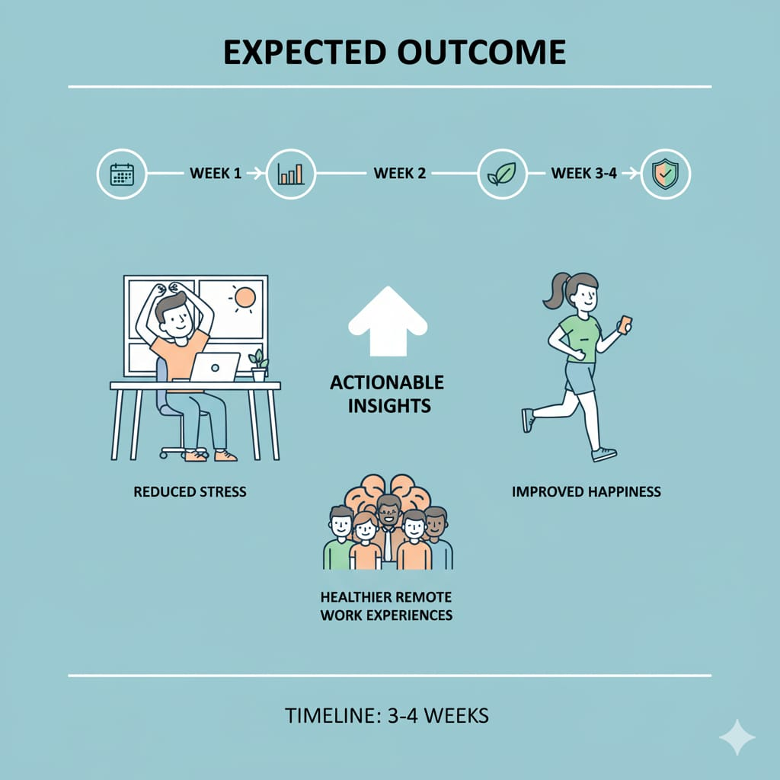
Conclusion
This project aims to provide valuable insights into the connection between remote work and mental health. By analyzing existing datasets with Excel and Power BI, the Mentalytics Team hopes to recommend practical measures that enhance employee well-being and support a healthier, more productive work environment.

